Slide 1





AI-Powered Crop Recommendation
Team : Jogeswara Rao Nimmaka & nimmakajogeswararao@gmail.com
Guided by: Abdul Aziz
Disclaimer: The content is curated for educational purposes only.
Notes:
Slides: Prepare a short slide deck (10-12 slides) summarizing the project objectives, methodology, and key results.

Slide 2
OUTLINE
Abstract of the Project
Problem Statement
Proposed Solution
System Architecture
Live Demo of the Project
Embedded Video of Project
Conclusion
Future Scope

Slide 3
Abstract
The AI-Powered Crop Recommendation System is an innovative application designed to enhance agricultural productivity by providing data-driven crop selection guidance to farmers. Leveraging advanced machine learning algorithms, the system analyzes critical factors such as soil quality, weather conditions, and historical crop data to generate personalized crop recommendations. The goal is to assist farmers in making informed decisions that maximize crop yield, resource utilization, and overall sustainability.
Developed as a user-friendly web application using Flask, the system allows farmers to input relevant data and receive real-time recommendations tailored to their specific environmental conditions. By integrating predictive models with an accessible interface, the project aims to bridge the gap between agricultural knowledge and practical farming, ultimately contributing to more efficient and sustainable farming practices. This project underscores the potential of technology to transform traditional agriculture, providing scalable solutions for improved food security and economic growth.

Slide 4
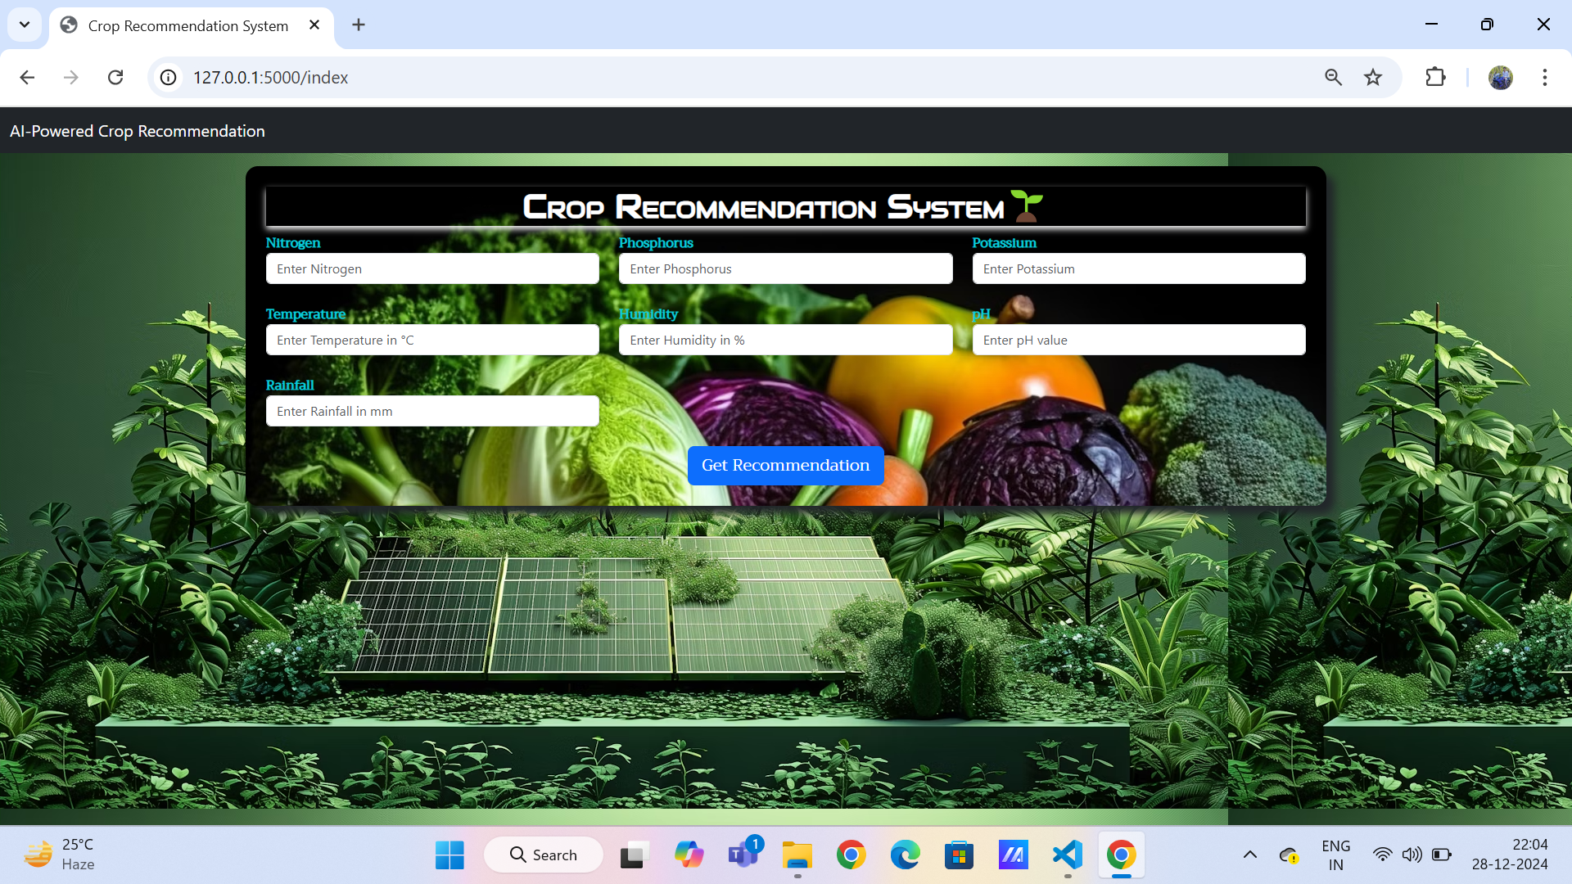
Problem Statement

Slide 5
Problem Statement
In many agricultural regions, farmers face significant challenges in selecting the most suitable crops for cultivation due to the variability in soil quality, climate conditions, and other environmental factors. Traditional methods of crop selection often rely on experience and intuition, which may not always result in optimal yield and resource utilization.
Key Issues:
Soil Variability: Different fields and regions have varying soil compositions, affecting nutrient availability and crop suitability.
Climate Conditions: Fluctuating weather patterns, including temperature, humidity, and rainfall, play a critical role in crop growth and yield.
Resource Utilization: Inefficient use of resources such as water, fertilizers, and land can lead to wastage and economic loss.
Lack of Data-Driven Guidance: Many farmers lack access to advanced tools and data-driven insights that can aid in making informed decisions about crop selection.
Impact: These challenges can lead to suboptimal crop yields, financial losses for farmers, and inefficient use of agricultural resources. There is a pressing need for a reliable, data-driven solution that can analyze various environmental factors and provide precise crop recommendations to enhance agricultural productivity and sustainability.
This problem statement sets the stage for the AI-Powered Crop Recommendation System, which aims to address these issues by leveraging machine learning to offer personalized crop selection guidance to farmers, thereby optimizing crop yields and resource utilization.

Slide 6
Proposed Solution
Solution Overview:
Data Collection and Analysis:
Gather data on soil quality, climate conditions, and historical crop yields from reliable sources.
Utilize sensors, satellite imagery, and existing agricultural databases to ensure comprehensive data coverage.
Machine Learning Model:
Develop and train machine learning models using the collected data to predict the most suitable crops for given environmental conditions.
Use algorithms such as Random Forest, Decision Trees, or Support Vector Machines to enhance the accuracy of predictions.
Web Application with Flask:
Implement a user-friendly web application using the Flask framework.
Allow farmers to input relevant data such as soil nutrients, pH levels, temperature, humidity, and rainfall through an intuitive interface.
Prediction and Recommendations:
Integrate the trained machine learning models with the web application to provide real-time crop recommendations.
Display the predicted optimal crops along with detailed insights and rationale behind the recommendations.
Visualization and Reporting:
Generate visual representations of the data and predictions to help farmers understand the analysis.
Offer reports that outline the recommended crops, potential yields, and best practices for cultivation.

Slide 7
System Architecture
The system architecture of the AI-Powered Crop Recommendation System can be broadly divided into several key components
Data Collection and Storage
↓
Data Preprocessing
↓
Machine Learning Model Training
↓
Web Application (Flask)
↓
User Input (Forms) Model Integration
↓
Prediction and Output
↓
User Interface and Visualization

Slide 8
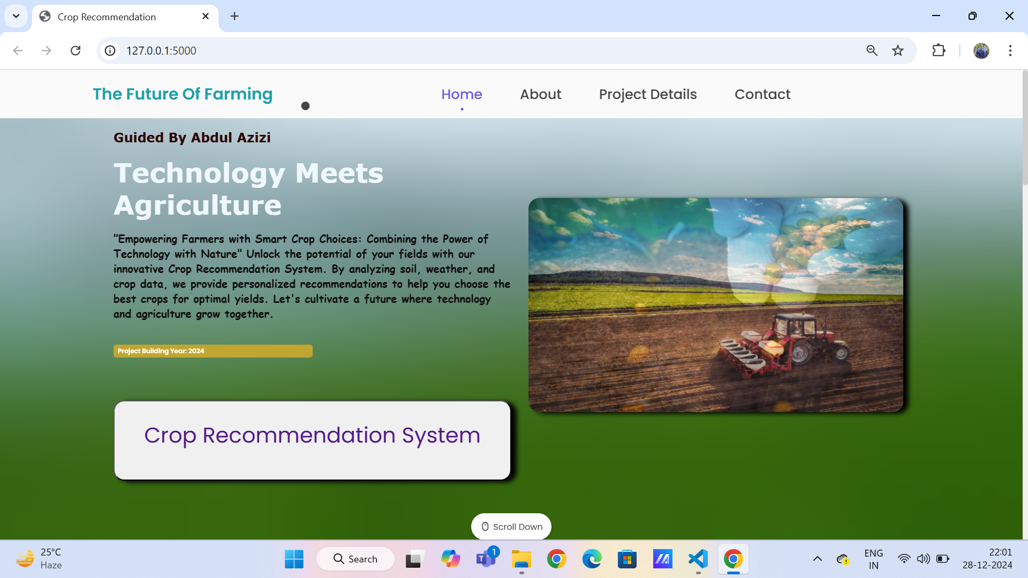
Live Demo of Project
Introduction:
"Welcome to the live demo of our AI-Powered Crop Recommendation System. This project aims to help farmers make informed decisions about crop selection based on their specific environmental conditions."
Accessing the Web Application:
"Let's start by accessing our web application. As you can see, the interface is clean and user-friendly."
Input Form:
"Here, we have an input form where farmers can enter data such as Nitrogen, Phosphorus, Potassium, Temperature, Humidity, pH, and Rainfall. Let's fill out an example."

Slide 9
Live Demo of Project
Submitting Data:
"After entering the data, we simply click 'Submit'. The system processes the data and sends it to our server."
Receiving Recommendations:
"Based on the input data, the system has recommended the following crops: [example crops]. These recommendations are tailored to the specific conditions provided."
Visualizations and Reports:
"We also provide visualizations to help farmers understand the analysis. For example, here's a chart showing the soil nutrient levels."
Additional Features:
"Additionally, our system allows users to compare different crops and view historical data for better decision-making."
Real-Time Interaction:
"Feel free to ask any questions or even input your own data to see the results live.

Slide 10
Live Demo of the Project
We share my latest project presentation with you! Click the link below to watch the full video on YouTube and don't forget to like and share your thoughts. Your support means the world to me!
https://youtu.be/5vfsKu0mKq0?si=ocLw8gcQV_gb-Wva
https://youtu.be/5vfsKu0mKq0?si=ocLw8gcQV_gb-Wva Project Presentation Video

Slide 11
Conclusion
The AI-Powered Crop Recommendation System project demonstrates the significant potential of leveraging advanced technologies like machine learning to address critical challenges in agriculture. By providing data-driven insights and personalized crop recommendations, this system empowers farmers to make informed decisions that optimize crop yields, enhance resource utilization, and promote sustainable farming practices.
Throughout the project, we successfully integrated various components, including data collection, preprocessing, model training, and deployment through a user-friendly web application using Flask. The system's ability to analyze soil quality, weather conditions, and other environmental factors in real-time ensures that farmers receive accurate and timely recommendations tailored to their specific needs

Slide 12
Future Scope
The AI-Powered Crop Recommendation System holds great promise for further development and impact. Here are several areas where the project can evolve and expand to provide even more value to farmers and the agricultural community:
Integration with Real-Time Data Sources
Expansion of Crop Database
Advanced Analytical Tools
User Experience and Accessibility
Collaboration with Agricultural Experts
Environmental and Sustainability Impact
Integration with Government and Agricultural Programs
The future scope of the AI-Powered Crop Recommendation System is vast, with potential to significantly impact agricultural productivity, sustainability, and resilience. By continually innovating and expanding the system, we can empower farmers with the tools they need to thrive in an ever-changing agricultural landscape.

Slide 13
Thank you!
Notes:
thank you very much for joining this PPT, keep learning.
13

